Slide 1
COGS 138: Week 4 Section
January 26th, 2022

Slide 2
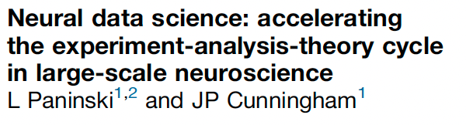
Reading #2

Slide 3
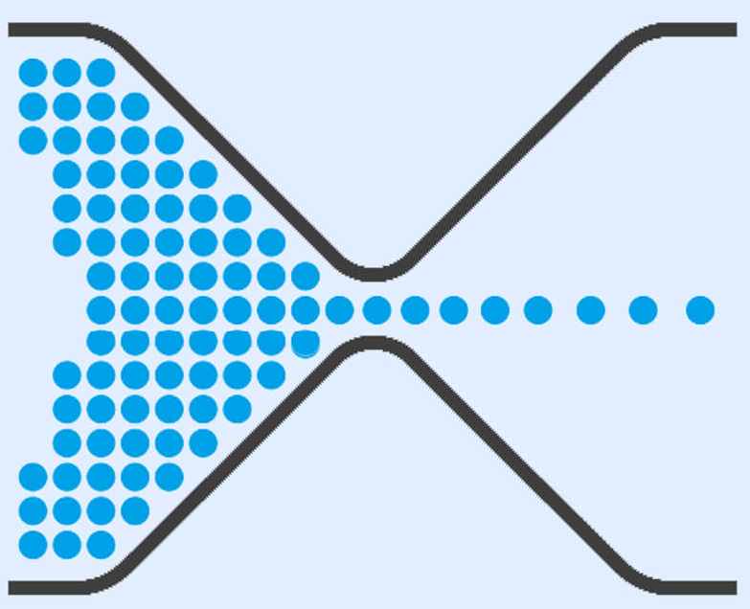
“High-Throughput” Neural Data
Neural data is being generated at record speeds.
The bottleneck in neuroscience research has switched from collecting data to interpreting data.

Slide 4
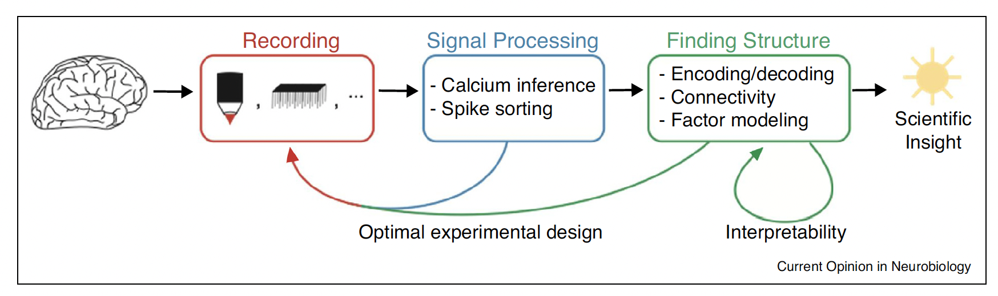

Slide 5
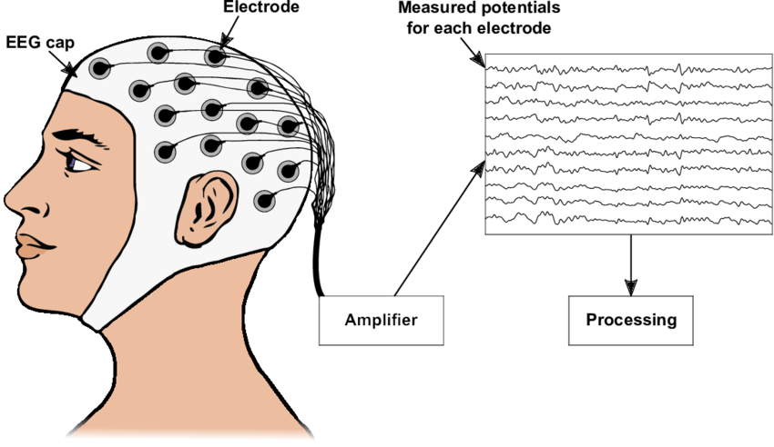
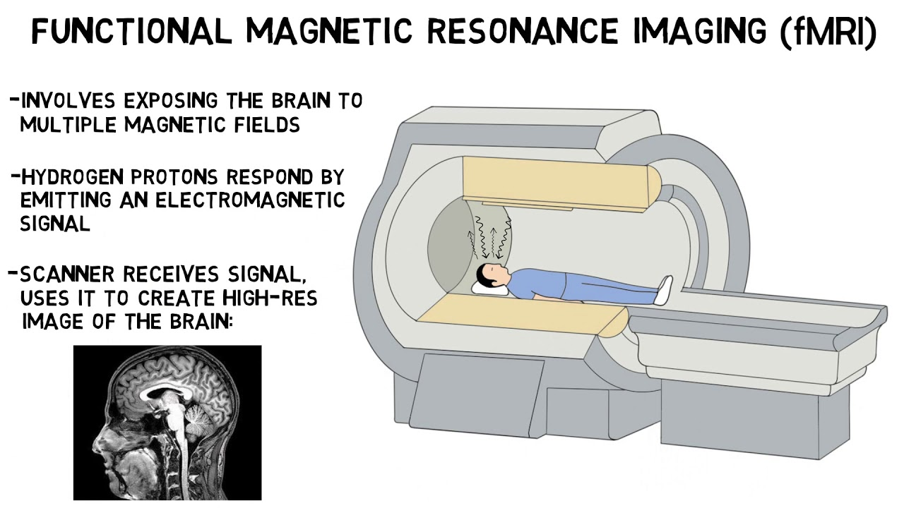
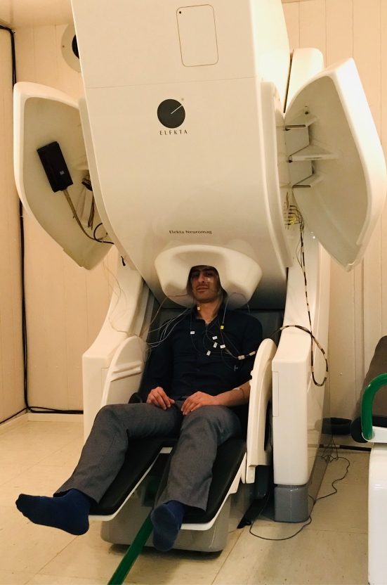
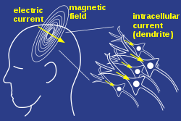
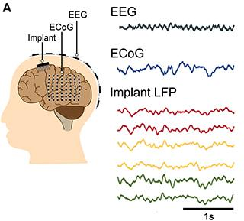
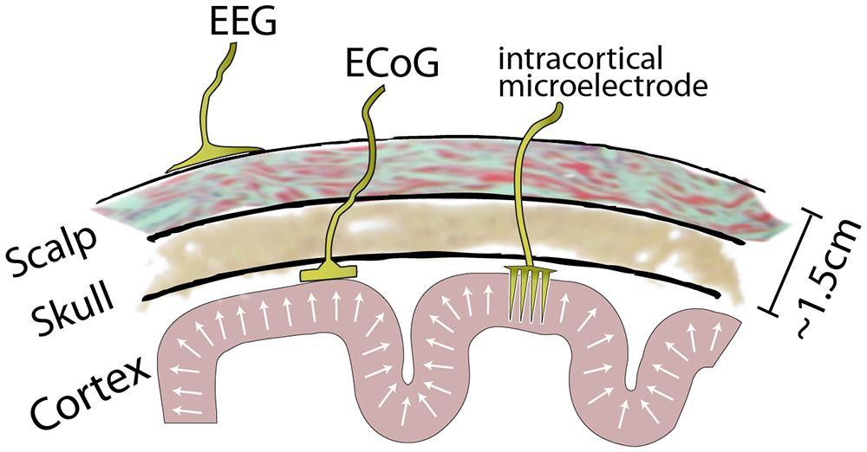
Neural Data Collection
Notes:
fMRI: indirect measure of brain activity via BOLD signal
Neurons need oxygen to fire
Haemodynamic response = blood releases oxygen to active neurons more than inactive neurons
fMRI detects the change in relative levels of oxygenated vs. deoxygenated blood based on the different magnetic susceptibility
MEG: slightly more direct measure of brain activity via magnetic fields produced by electrical currents
The net effects of ionic currents from neurons during synaptic transmission
EEG/ECoG/Implanted electrodes: direct measure of electrical brain activity
The currency of neurons is electricity and this neural data measures electrical activity
It gets complicated because you don’t know exactly what the electrical activity is measuring from
Buzsaki, 2012 paper
https://www.ncbi.nlm.nih.gov/pmc/articles/PMC4907333/

Slide 6
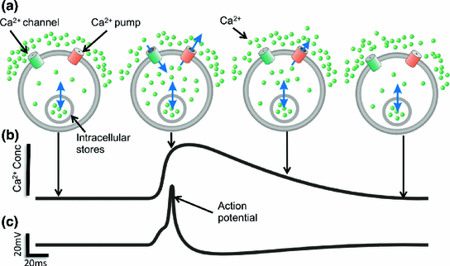
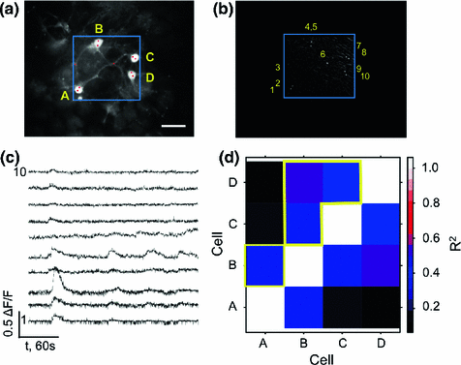
Neural Data Collection - Calcium Imaging
Castaneras et al., Advanced Optical Methods for Brain Imaging, 2018
Notes:
First, what is it? via wikipedia
"A microscopy technique to measure calcium (Ca2+)"
"In neurons, electrical activity is always accompanied by an influx of Ca²⁺ ions. Thus, calcium imaging can be used to monitor the electrical activity in hundreds of neurons"
Advantages:
Cell-type specificity
Less invasive
Couples easily with genetic tools
Can record from a LARGE amount of neurons
Experimental design flexibility
Can control which subset of neurons to image at specific times
Disadvantages:
Not directly measuring neural activity
Requires denoising, temporally deconvolving, and spatially demixing to estimate spiking
"identify the locations of the neurons, demix spatially overlapping components, and denoise and deconvolve the spiking activity from the slow dynamics of the calcium indicator"
Nonnegative matrix factorization (NMF) tries to solve this problem by simultaneously demixing/deconvolving
How to improve this area of research in the future:
'Gold standard' datasets that can objectively be used to score algorithm performance
This could automate the denoising process for calcium imaging
An example of this: IARPA MICRONS project
Optimization of experimental design & analysis methods to image larger populations at higher temporal resolution
Spatial resolution can be sacrificed for temporal
Especially if we have knowledge about cell-specificity
Measure single-neuron activity in small moving animals with flexible nervous systems

Slide 7
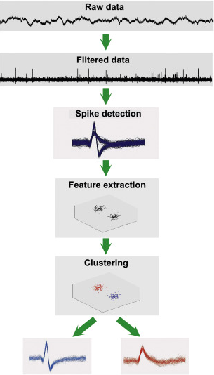
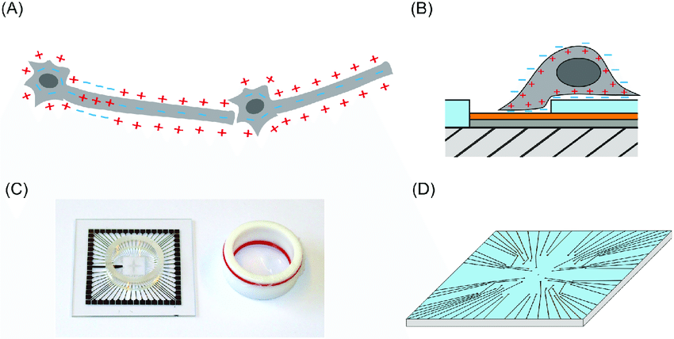
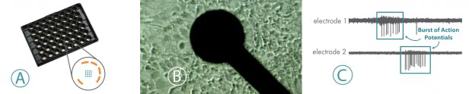
Neural Data Collection - Multielectrode Arrays (MEAs)
Schürmann et al., PLoS ONE, 2018
Axion Biosystems
Rey et al., Brain Research Bulletin, 2015
Notes:
The origins of the microelectrode array (MEA) come from the desire of neuroscientists to record neuronal activity “at a large number of points, over periods of days or weeks” in order to study the “development and plasticity of electrical interactions among the cultured element” with “a convenient non-destructive method” (Thomas et al, 1972).
A multi-electrode array is a grid of tightly spaced microscopic electrodes embedded in the bottom of each well in a multi-well MEA plate.(Figure A). Electrically active cells, such as neurons or cardiomyocytes, can be cultured over the electrodes (Figure B). Over time, as the cultures become established, they form cohesive networks and present an electrophysiological profile (Figure C). The resulting electrical activity, spontaneous or induced firing of neurons, or the uniform beat of cardiomyocytes, is captured from each electrode on a microsecond timescale providing both temporally and spatially precise data.
Spike sorting, what is it? via scholarpedia
"the grouping of spikes into clusters based on the similarity of their shapes"
"each neuron tends to fire spikes of a particular shape, the resulting clusters correspond to the activity of different putative neurons. The end result of spike sorting is the determination of which spike corresponds to which of these neurons"
Spike sorting can have some manual intervention to get higher SNR with small-scale recordings
This is impossible with large-scale multielectrode arrays (MEAs)
Too much data
Future solutions:
"Triage-then-cluster" approach
Matching pursuit algorithm to lower the computational demand
Gold standard datasets
Can use optogenetic tagging methods
Some neurons are activated at known times
Known brain region neural activity
Ex: mosaic tiling of receptive fields in primate retina
Simulations
Clusterless decoding
Take into account the 'unsorted' spikes that have a lower SNR

Slide 8
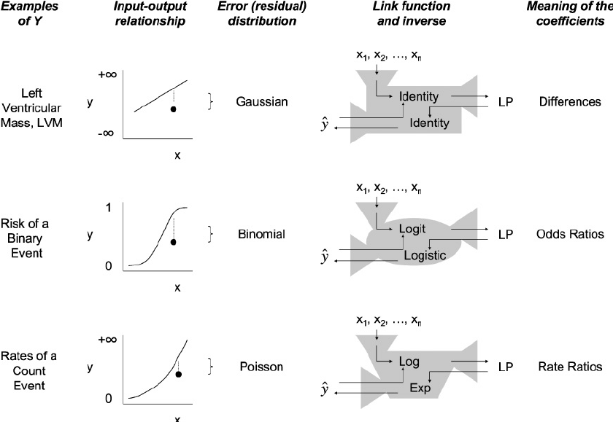
Neural Data Interpretation: Encoding & Decoding
How the brain encodes external variables into spike trains:
Generalized Linear Models (GLMs)
Spike trains can be regressed against behavior, hidden factors, and other spiking in the population
Ravani et al., Nephrology Dialysis Transplantation, 2008
Notes:
Ordinary linear regression predicts unknown quantity (response variable) as a linear combination of a set of observed values
Constant change in predictor --> constant change in response
Response variables have normal distributions
GLM's generalize ordinary linear regression by "allowing for response variables that have arbitrary distributions, and for an arbitrary function of the response variable (the link function) to vary linearly with the predictors (rather than assuming that the response itself must vary linearly)"
Spike trains can be regressed against behavior, hidden factors, and other spiking
GLMs can predict nonlinear responses
If they have a good 'feature set' (collection of variables to regress against the neural activity)

Slide 9
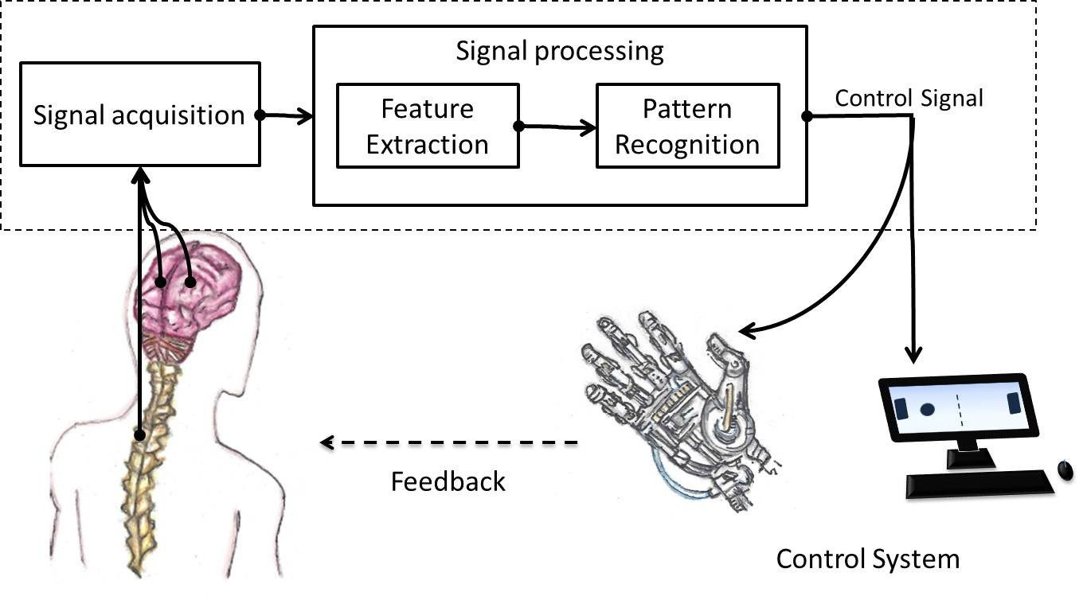
Neural Data Interpretation: Encoding & Decoding
How to decode external variables from spike trains:
Brain-Computer Interfaces (BCI)
Discriminative vs. Generative Models
Artificial Neural Networks (ANNs)
Notes:
Brain-Machine Interfaces
ReFIT (2012)
Decoding algorithm that has improved the field of BCI in the motor cortex
"To improve the performance of neural prostheses, we focused on a systems engineering approach. Building on existing methods in the field, we developed two key innovations that alter the modeling assumptions made by these algorithms and the methods by which these algorithms are trained. In addition, we chose signal-conditioning methods, which transform recorded neural signals into control algorithm input, to improve system stability and performance^{15,16}. As demonstrated in closed-loop neural control experiments, these methods resulted in high performance across multiple cursor-control tasks"
More constrained models of neural variability can construct better decoders
Discriminative models vs. Generative models
"Discriminative models draw boundaries in the data space, while generative models try to model how data is placed throughout the space. "
"A generative model focuses on explaining how the data was generated, while a discriminative model focuses on predicting the labels of the data."
Discriminative might be > than generative for decoding
ANN (artificial neural networks)
Convert an encoding model + samples from prior stimulus distribution to optimal Bayesian decoder

Slide 10
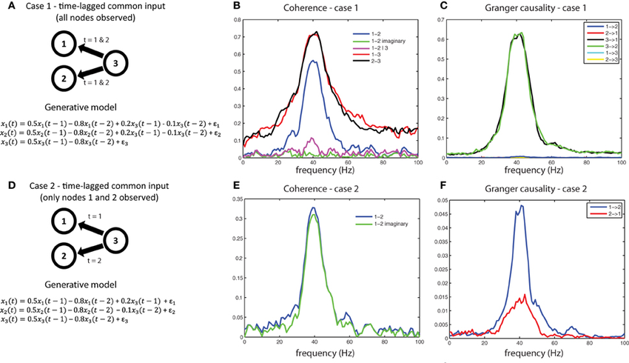
Neural Data Interpretation: Connectivity Estimation
Common Input Problem
Correlated neural activity
Connected brain regions
Brain network functionality
Predicting future network dynamics
???
Bastos and Schoffelen., Frontiers in Systems Neuroscience, 2016
Notes:
Neural activity is correlated --> Does this imply it is connected?
Connectivity --> Network functionality --> Predicting FUTURE network dynamics
Lots of implications involved here
Common input problem:
Which 'connections' are causal vs. correlations based on an unobserved common input
Shotgun experimental design:
Image subsets of a network one at a time
Use stats to estimate the full network connectivity
Verification of connectivity:
Optogenetics

Slide 11
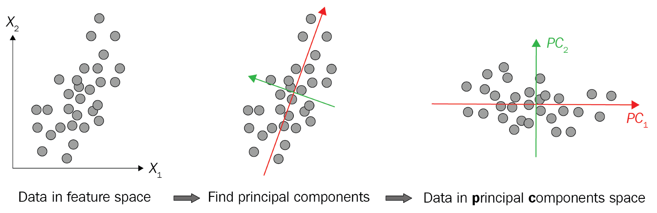
Neural Data Interpretation: Factor Models
Dimensionality Reduction
Find the underlying, low-dimensional, hidden signal from the high-dimensional, complex neural activity
Usually using Bayesian paradigms
Notes:
Dimensionality reduction:
Find the underlying, low-dimensional, hidden signal from the high-dimensional neural activity
Based on some hypothesis
Usually using a Bayesian paradigm
"generative probabilistic model is stipulated to link low-dimensional latent signals to high-dimensional neural spike trains, and then a computational inference procedure recovers the posterior distribution of the latent variable from the observed data"
Examples of dimensionality reduction in neuroscience discoveries:
Mixed selectivity in PFC
Even though single neuron activity gets extremely complex, you can find behavioral correlates at the population level
“This new representation consists of a few fundamental activity components that capture 95% of the firing rate variance of >800 neurons. Surprisingly, the memory-related activity components account for <20% of this firing rate variance. The observed heterogeneity of neural responses results from random combinations of these fundamental components. Based on these components, we constructed a generative linear model of the network activity. The model suggests that the representations of time and memory are maintained by separate mechanisms, even while sharing a common anatomical substrate.”
Different computations in brain regions are computed in specific subspaces of neural populations
And there are constraints on learning based on these subspaces

Slide 12
Interpretability of Large-Scale Neural Data Analysis
Three potential concerns
Are the results from these novel tools simply the same results we already knew from prior research?
Does having more data really produce more findings?
Will these approaches create a real understanding of the brain?
Solution: Accelerate the experiment-analysis-theory cycle
Notes:
Are the results from these novel tools simply the same results we already knew from prior research?
It might just look shinier because it's a new way of framing the same thing
Does having more data really produce more findings?
Does the task also have to be more complex? Or can the same simple questions with more data give us that much more information?
Will these approaches create a real understanding of the brain?
We are producing more data than ever before, now we are in need of theories that are actually tethered to this data
We are reaching a stage we thought was only sci-fi
We'll be able to measure with precision the spatial and temporal activity from neurons while doing some behavior
Solution: accelerate the experiment-analysis-theory cycle

Slide 13
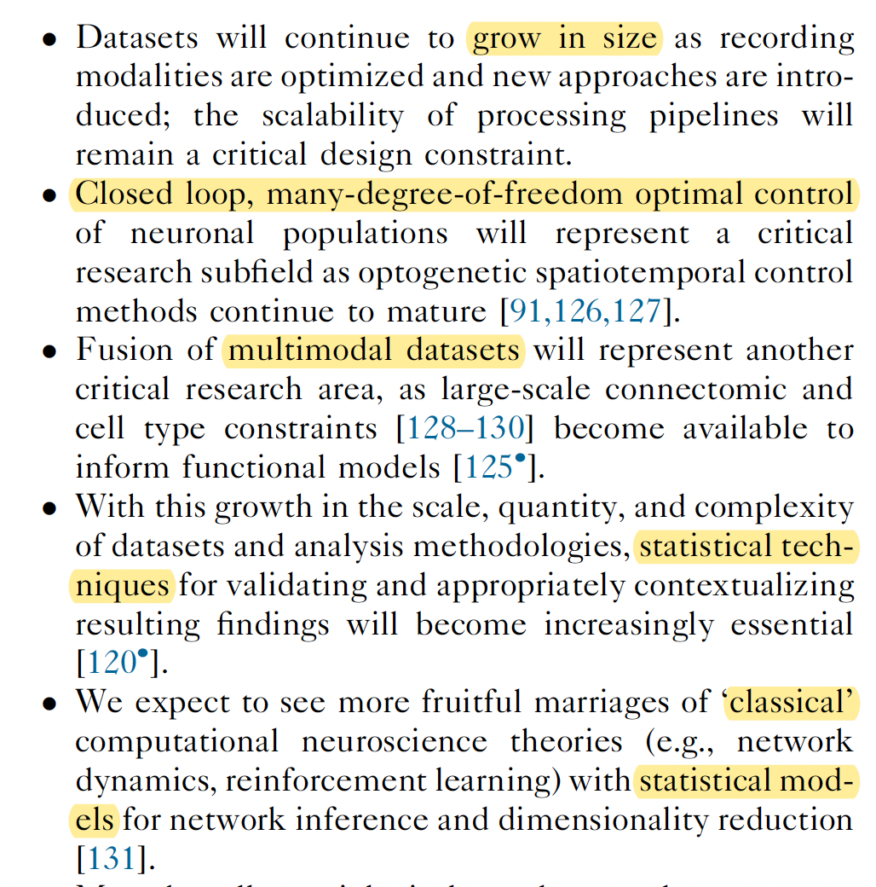
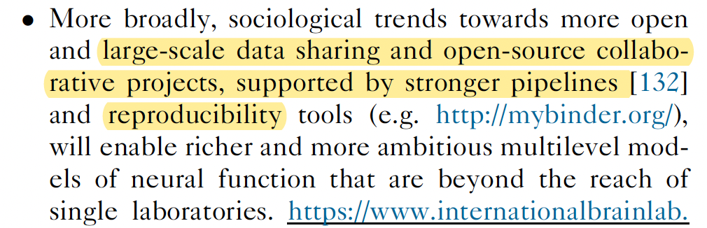
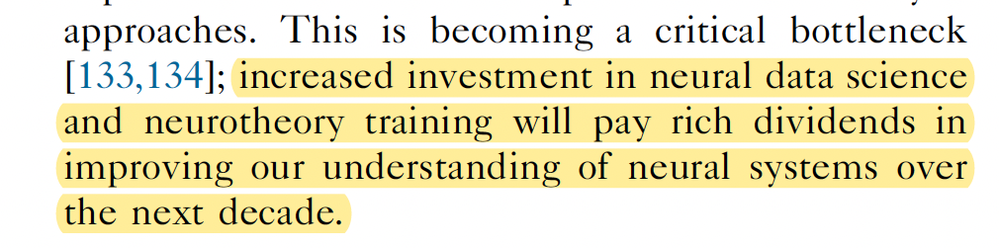
The Future of Neural Data Science

Slide 14

Questions about A2? (due this Friday)
LISC (LIterature SCanner): a package for collecting and analyzing the scientific literature
You will be:
Making your own search for keywords
Using methods in LISC to compare keywords, areas of the brain, etc.
https://lisc-tools.github.io/lisc/index.html
Notes:
A direct implementation of using data science tools, like text mining, in the scientific method (to accomplish hypothesis generation/general exploration).

Slide 15
General Announcements and Reminders
A2 due this Friday (1/28/22) at 11:59 PM (PST)
Post on slack about questions
Reading Quiz due next Friday (2/4/22) at 11:59 PM (PST)
Reading quiz release TOMORROW
Three attempts
We will grade your last attempt, not your best attempt

